Slide 1
Individual homework-exercise 7.2 Resolution Proposition
Student: Costin Carmen Ștefania Cornelia Group:912

Slide 2
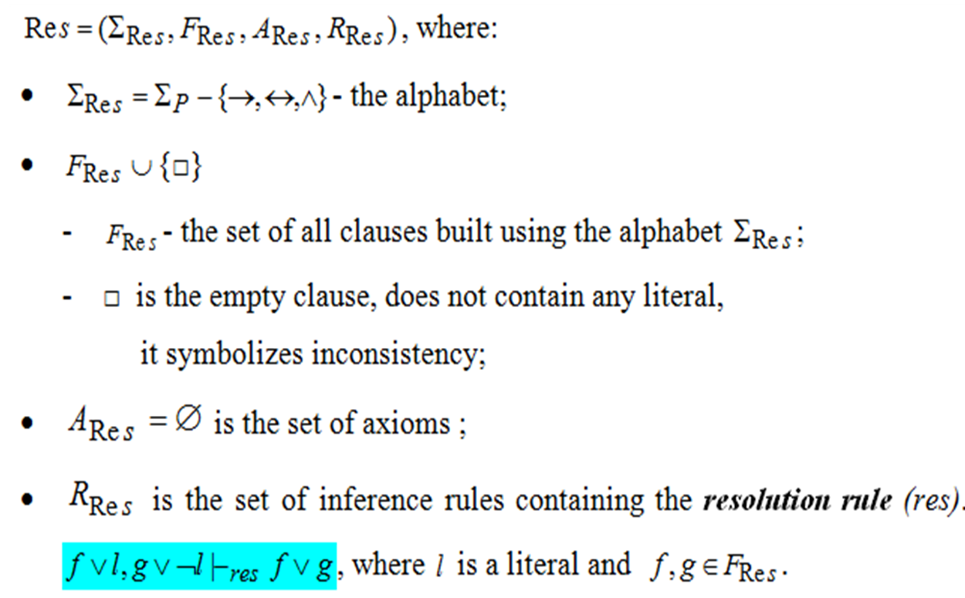
Theoretical results
Resolution method

Slide 3
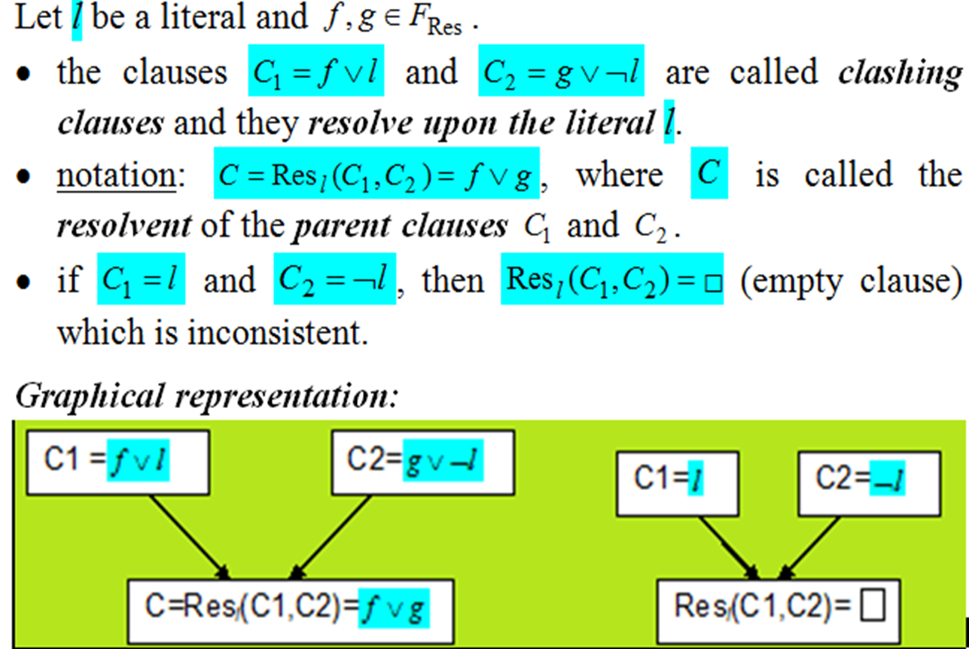
Definitions

Slide 4
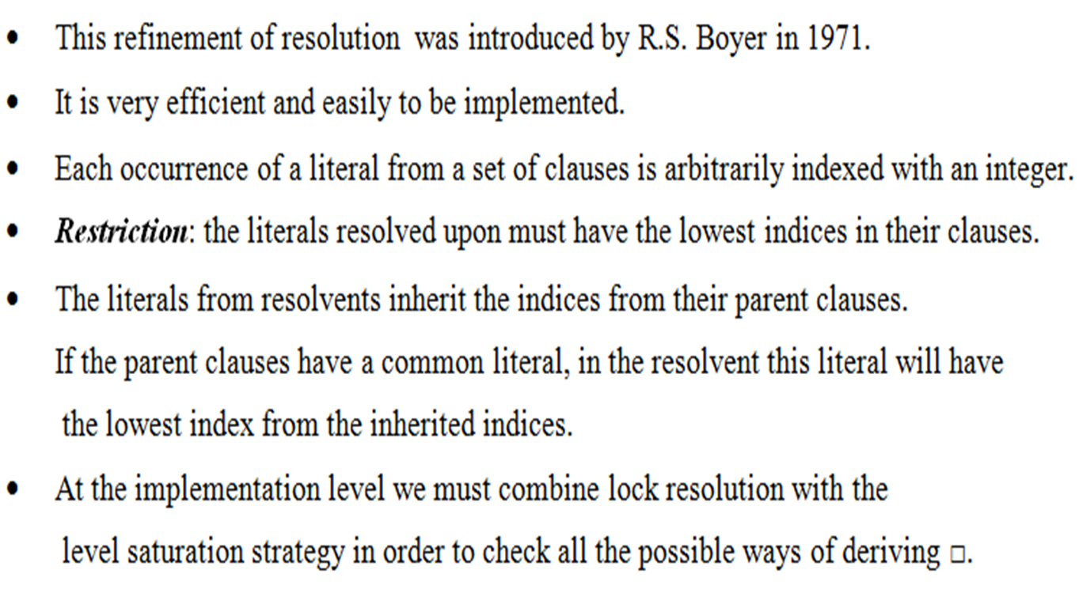
Lock Resolution

Slide 5
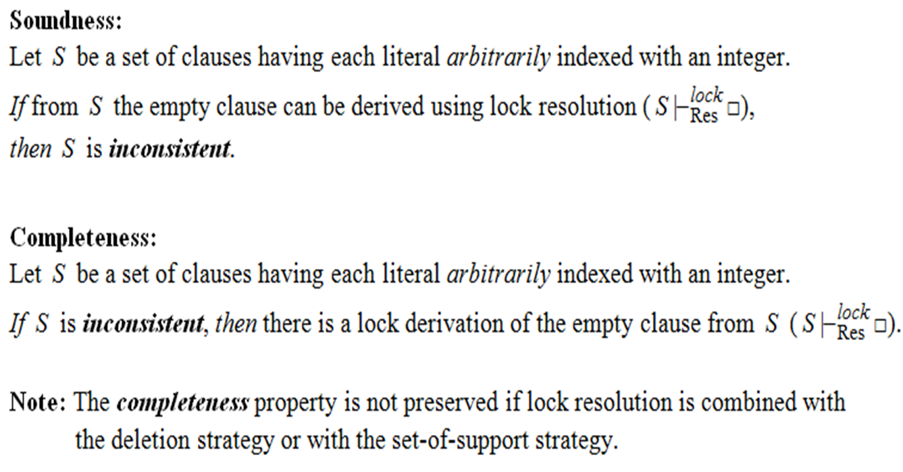
Theorems – Lock resolution

Slide 6
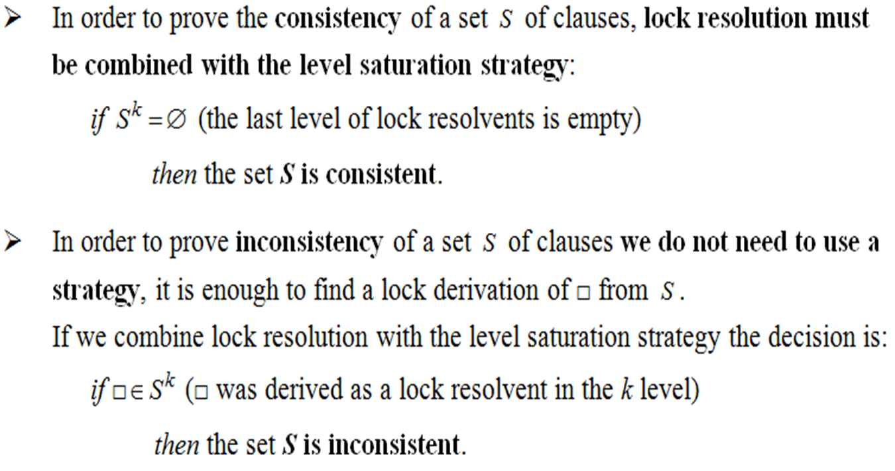
Remarks

Slide 7

We denote the propositional clauses as follows and indexing of the literals:
C1=₍₁₎pv₍₂₎-r , C2=₍₃₎ qv₍₄₎r, C3=₍₅₎₋pv₍₆₎₋r, C4=₍₇₎-qv₍₈₎₋r
We use the level saturation strategy
S ⁰ = S ={C1,C2,C3,C4}
S ¹ ={Res ^{lock} (Ci , Cj) | C i , Cj ∈ S ⁰ }
C5=Resp ^{lock}(C1,C3)=₍₂₎-r
S ¹ = { C5}
S² = Ø
No lock resolvents can be generated , the empty clause cannot be derived from S and we conclude that the set is consistent

Slide 8
Another indexing :
C1=₍₁₎pv₍₂₎-r , C2=₍₅₎ qv₍₆₎r, C3=₍₄₎₋pv₍₃₎₋r, C4=₍₈₎-qv₍₇₎₋r
S ¹ =Ø
No lock resolvents can be generated , the empty clause cannot be derived from S and we conclude that the set is consistent

